Slide 1



AI for Developers
Alex Drenea
Cloud Solution Architect
Microsoft

Slide 2
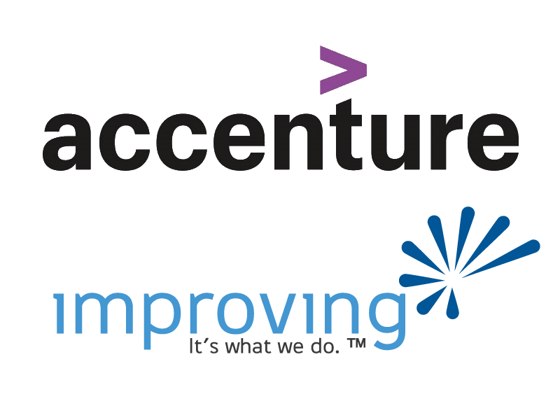

Slide 3
Why AI ?
Notes:
Building a demo environment for a presentation
Settled on building the “backend” system for an ordering system for a coffee shop. Need some “seed” data for my database, as well as the ability to generate random real-time new orders.
What do I need:
Realistic coffee shop product catalogue
Realistic coffee shop locations
Representation of an actual “order”
Options:
- Produce random products, prices, categories etc.. and type them in ☹
- Look for some online database of products, download, “massage” and write some code to read them and randomize them ☹
Either way, time consuming and or not very diverse or accurate.

Slide 4
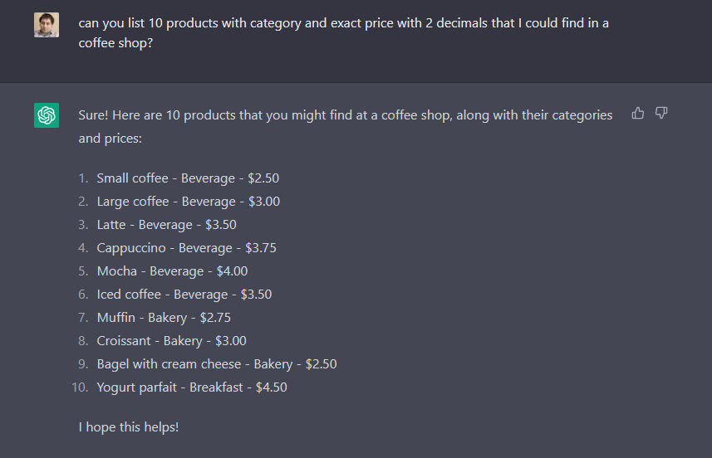

Slide 5
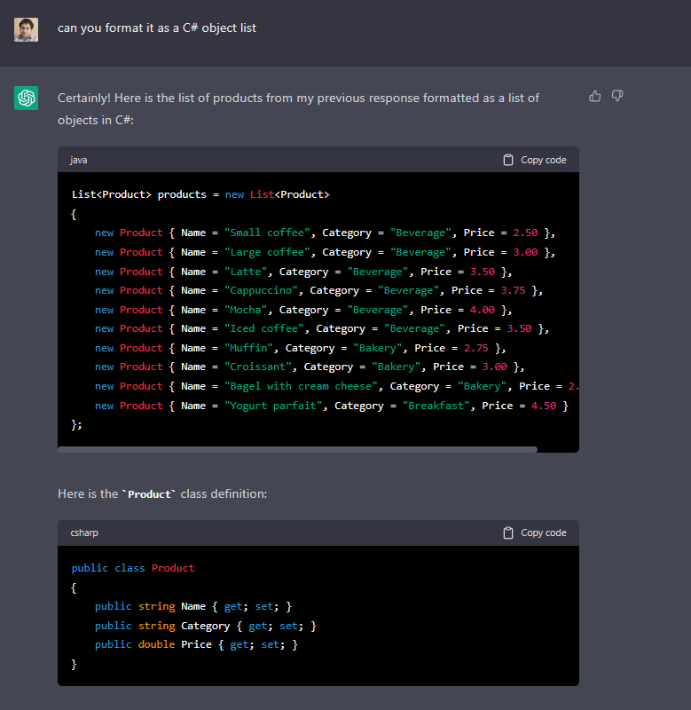

Slide 6
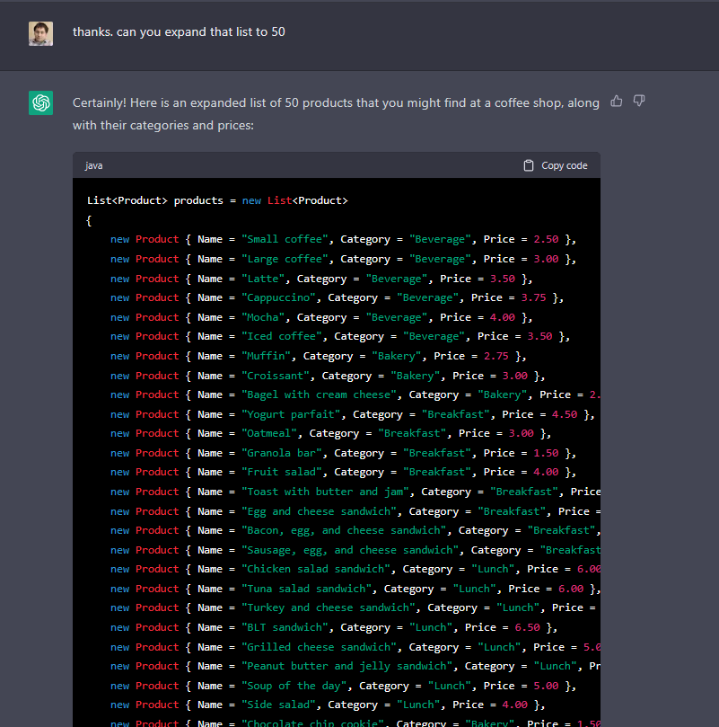

Slide 7
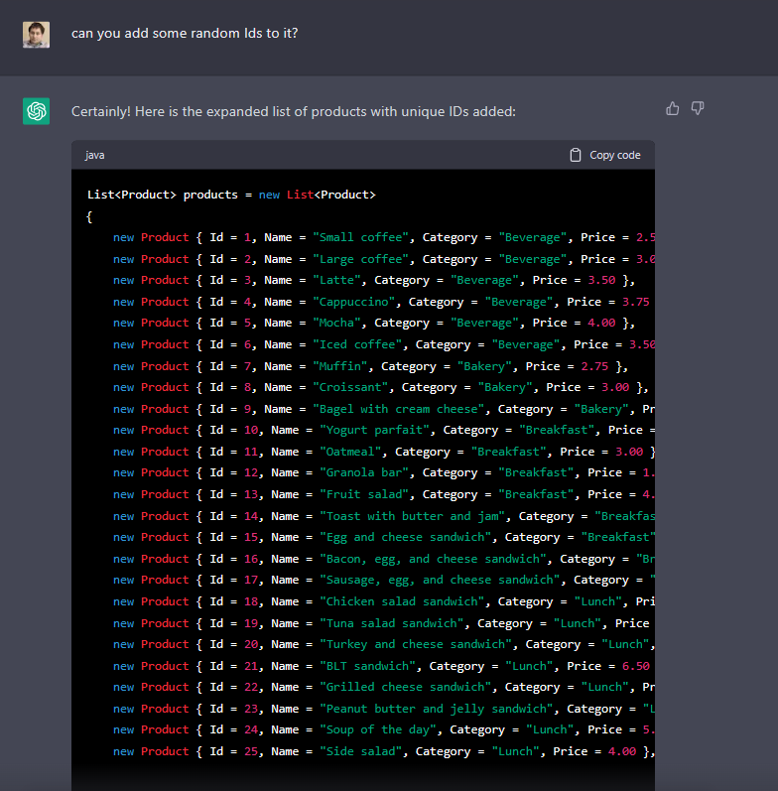

Slide 8
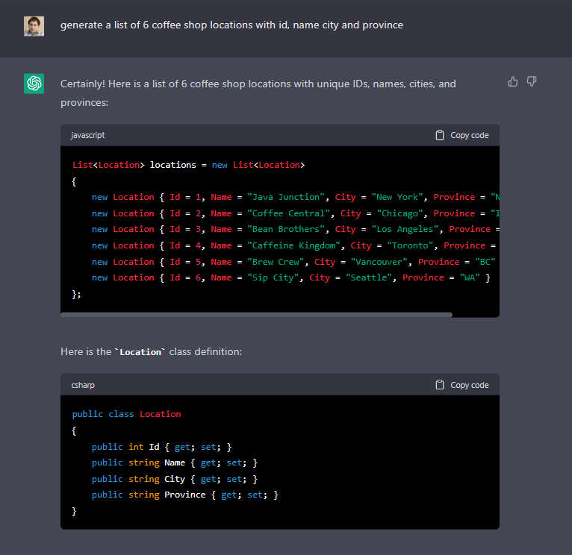

Slide 9
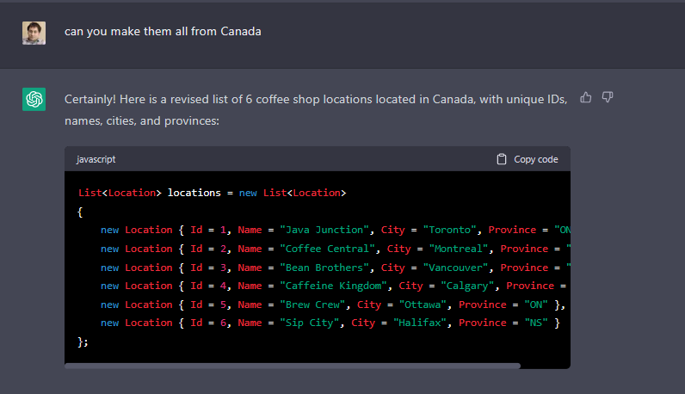

Slide 10
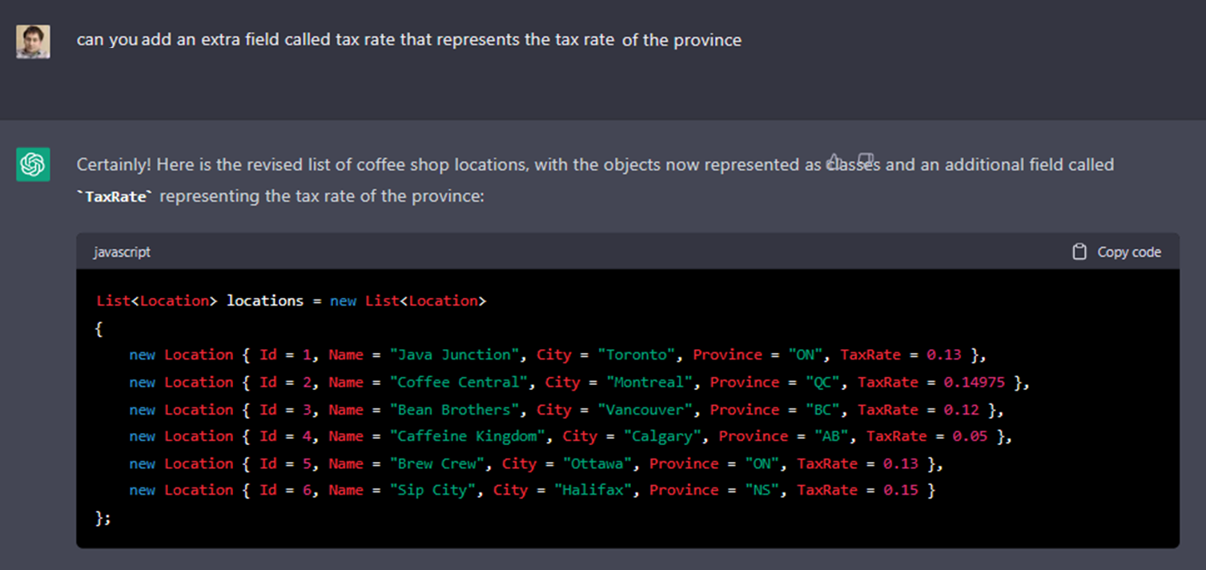

Slide 11
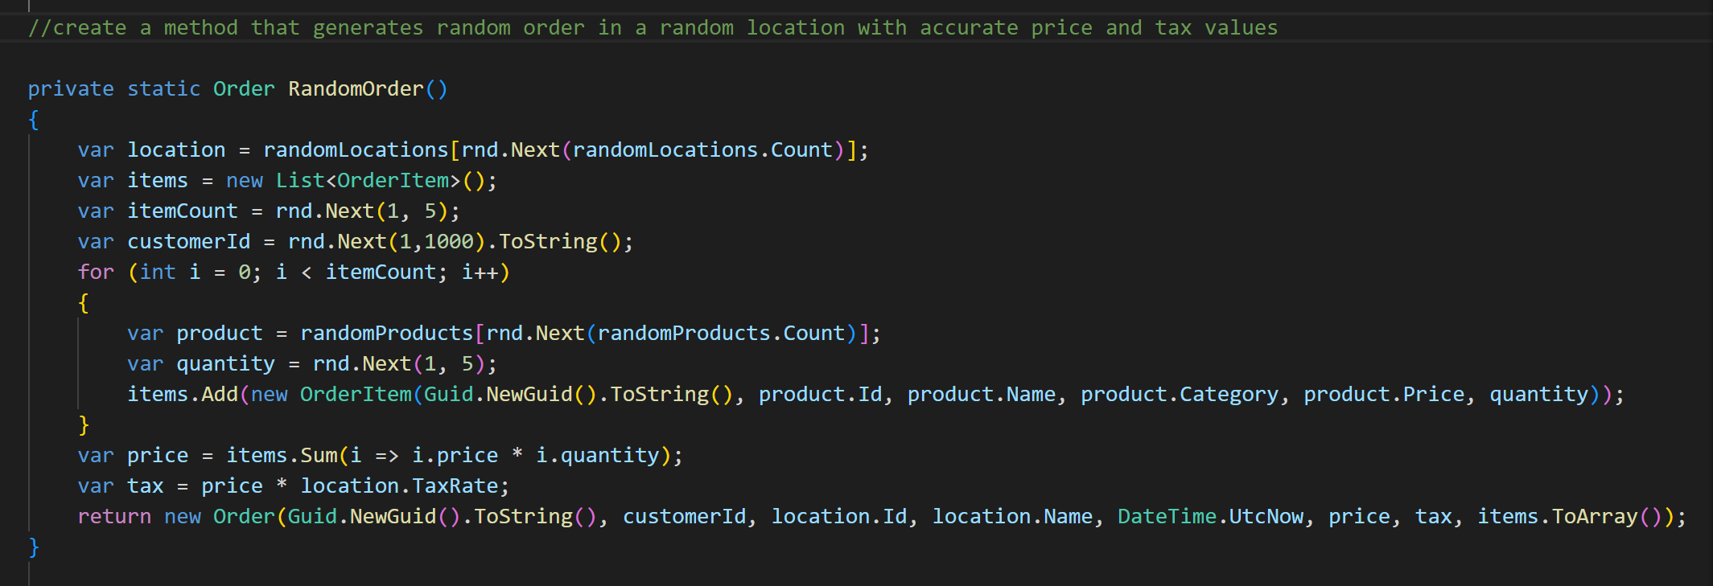
Hooray! We have the data…
We need some codes to combine the “seed” data into “order” objects
Fire up VS Code (or VS) and let another AI do the work…
Enter GitHub CoPilot and GitHub CoPilot Chat

Slide 12
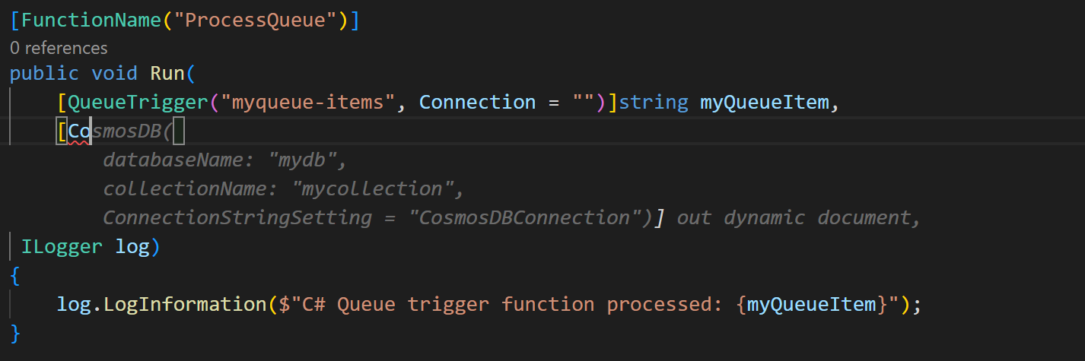
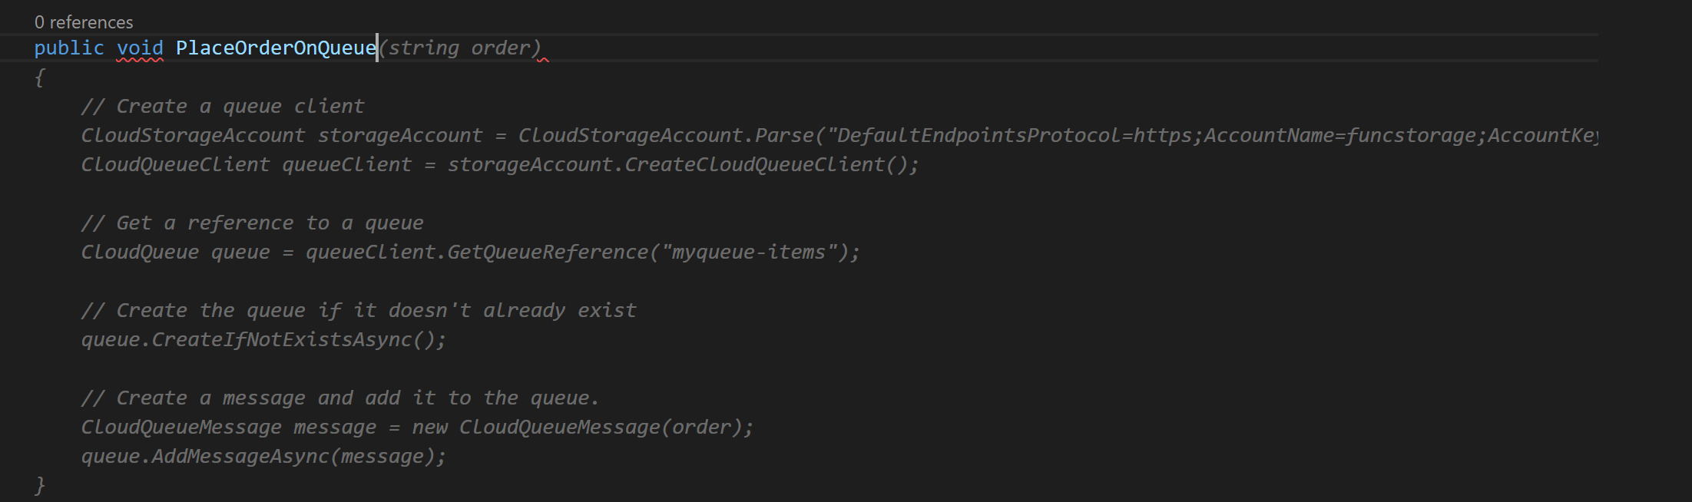
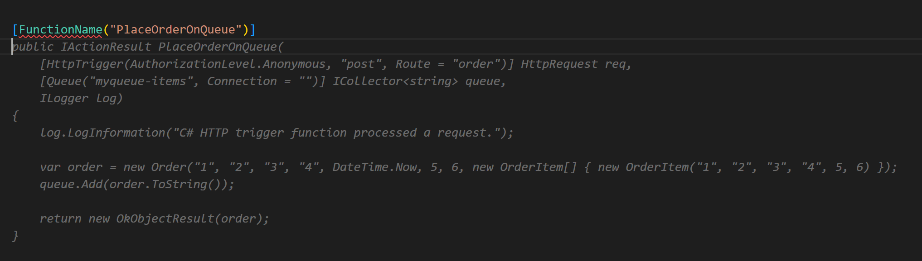

Slide 13
Notes:
Slide that shows some Copilot Chat examples in Vs and Vs code

Slide 14
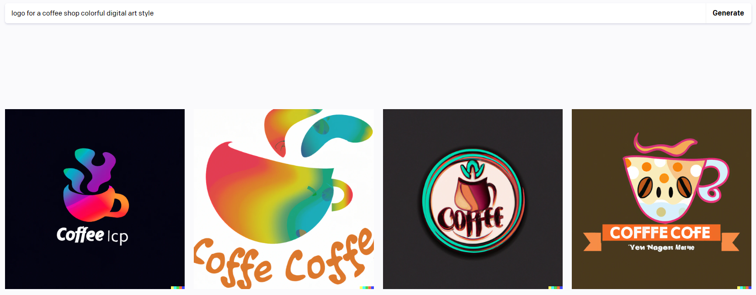
For bonus points, I wanted a nice logo for our demo….
Let’s give Dall-E a try

Slide 15
AI landscape…

Slide 16


Ensure that artificial general intelligence (AGI) benefits humanity.
Empower every person and organization on the planet to achieve more
Notes:
So Microsoft and openAI partnership started in 2020, when both company decided to invest together, mostly on the infrastructure perspective.
Fun fact, as part of the first $1B investment, Microsoft committed and delivered the infrastructure required to run the training for the OpenAI models. That resulted in building the 5th largest suprtcomputer in the world at the time
Since then, the partnership grew. Everything OpenAI today, even the open Ai website is running on the Azure platform.
Both are running on the Azure architecture and infrastructure, so the for example all the investment that you've done with the on Azure from an infra perspective to build your project or to enable your customer know that thanks to in addition to all the partner that we're working with from the open air, we learn a lot to improve also infrastructure.
So this is happening, and this is this is a feedback loop that is going both side.
GPT 3 implementation, as I was saying earlier, it was starting in 2022 with the Open Ai API that was available at that time.
DALL-E and clip model was available in 2021 on the OpenAI perspective and then from an Azure perspective, everything was being rolled out in November 2021, when Azure open AI started as a private preview for specific user and customer.
From there, a lot of learning have been done and gathered to improve the experience, to improve the use case and also come out with actual solution accelerator that I'm going to share and that's going to address your first use case.
And as of Dec 2022, Azure OpenAI was GA on the Azure platform.
So everyone is very focused on chatGPT, which happened in January, but Azure OpenAI has been GA since December 2022, and through forms you can get access and have your subscription enabled on that.

Slide 17



Generative AI
GPT 3.5
GPT 4
DALL·E
Whisper
Generate and Understand Text
Generate images from text prompts
Transcribe audio
Prompt: A white Siamese cat
Response:
Prompt: file.wav
Response:
Spoken content in file!
Prompt:
Write a tagline for an ice cream shop.
Response:
We serve up smiles with every scoop!

Slide 18


Azure OpenAI Service
Deployed within your Azure subscription, secured by you, accessed only by you, and tied to your datasets and applications
Large, pretrained AI models to unlock new scenarios
DALL·E
GPT 3.5
Custom AI models fine-tuned with your data and hyperparameters
GPT 4
Whisper
Built-in responsible AI to detect and mitigate harmful use
Enterprise-grade security with role-based access control (RBAC) and private networks
Notes:
When you use Azure OpenAI Service, your prompts (inputs) and completions (outputs), your embeddings, and your training data
Are NOT available to other customers.
ARE NOT available to OpenAI.
Are NOT used to improve OpenAI models.
Are NOT used to improve any Microsoft or 3rdparty products or services.
Are NOT used for automatically improving Azure OpenAI models for your use in your resource (The models are stateless, unless you explicitly fine-tune models with your training data).
Your fine-tuned Azure OpenAI models are available exclusively for your use.

Slide 19
Azure OpenAI Service models
GPT-3
Codex
GPT-3.5
GPT-4
Davinci-001
Summarizing
Generating creative content
Davinci-codex
Generate code
Davinci-002/003
Primarily Chat
Summarizing
Code generation
GPT 4 – 8k
Chat
Summarizing
Code generation
Curie
Answering questions
Complex classification
Cushman-codex
Generate code
GPT 3.5 Turbo
Chat
Summarizing
Code generation
(0301)
GPT 4 – 32k
Chat
Summarizing
Code generation
Babbage
Semantic search ranking
Simple classification
GPT 3.5 Turbo (0613)
Chat
Summarizing
Code generation
GPT 4 Turbo – 128k
Chat
Summarizing
Code generation
Ada
Simple classification
Parsing and formatting text
Notes:
https://learn.microsoft.com/en-us/azure/ai-services/openai/concepts/legacy-models
https://learn.microsoft.com/en-us/azure/ai-services/openai/concepts/models

Slide 20
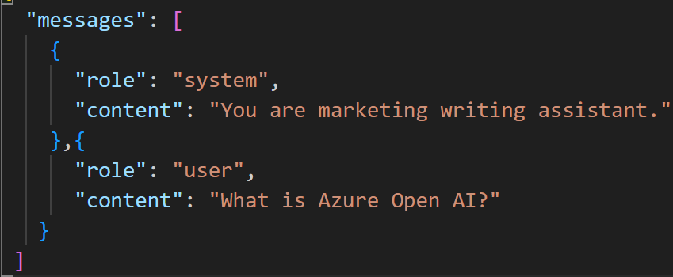
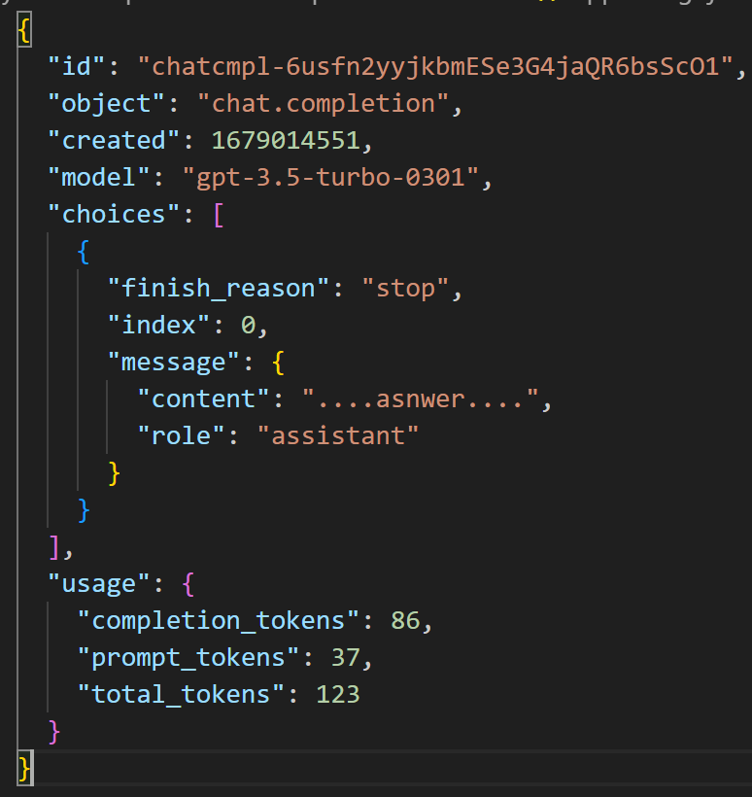
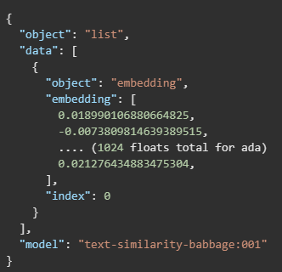
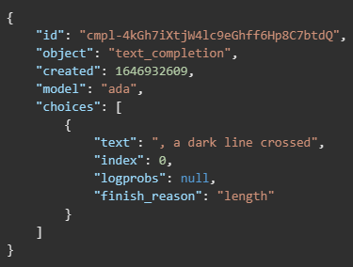
Azure Open AI - APIs
Completion
Chat
Embeddings
GPT-3.5
(v0301)
GPT-3.5
GPT-4
GPT-3
Text in – text out
“Text” in – message out
Text in – vector out
“once upon a time”
The food was delicious
Notes:
A completion model attempts to extend the user’s prompt with relevant text. For instance, if our prompt is “The horse is,” the model will likely respond with something like “a domesticated animal.” Completion models do not have conversational capabilities. We send a single request, receive a response, and that’s the end of the interaction.
On the other hand, chat models are optimized for engaging in conversations. While they technically function as completion models, they can tell apart who said what, leading to a more natural conversation flow. We can pose questions, receive answers, and make follow-up requests. Anyone who has used ChatGPT would be familiar with this type of interaction.
Direction is to move towards a chat interface.
Fun Fact - > Copilot is a good example of a completion implementation while, Copilot Chat (Vs and VSCode) is a chat based app.
https://learn.microsoft.com/en-us/azure/ai-services/openai/concepts/models
https://learn.microsoft.com/en-us/azure/ai-services/openai/how-to/work-with-code

Slide 21
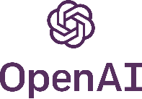
OpenAI vs Azure OpenAI
Innovation
Production
Unlock business value with new experiences
Prototype concepts in minutes, customize for production scale
Scale with enterprise-grade security and reliability
Apply AI responsibly
Notes:
Benefits of Azure OpenAI vs. OpenAI
WHO:
OpenAI: Startups looking for latest models and ISVs without pre-existing Azure relationships
AOI: Azure customers, enterprises, ISVs et
WHAT:
OpenaAI: Broad set of alpha and early-stage capabilities, Access through a playground and API set, Great experimentation and demo site – open access to all
AOI: need to request access, Access though playground and APIs,
PROD readiness
Open AI: Limited ResponsibleAI, no SLA or additional security / privacy features -> your data is their data!!!!
AOI: Azure Active Dir, Data residency & compliance, data security, Azure SLA guarantee, global availability zones, Responsible AI

Slide 22

















Azure AI landscape
Applications
Partner Solutions
Business Users
Application Platform
AI Builder
Power BI
Power Apps
Power Automate
Power Virtual Agents
Scenario-Based Services
Applied AI Services
Bot Service
Cognitive Search
Form Recognizer
Video Indexer
Metrics Advisor
Immersive Reader
Customizable AI Models
Cognitive Services
Developers & Data Scientists
Vision
Speech
Language
Decision
OpenAI Service
ML Platform
Azure Machine Learning
Notes:
And because from a MSFT perspective we want to enable all kinds of users, there is different levels of abstraction when it comes to machine learning
there is low-level abstraction with AML, which is a tool that allows data scientists to implement their own models based on their own use case
and also there's the customizable AI models (Cog Services), where we have pretrained models that are targeting vision, speech in speech-to-text and text-to-speech in multiple languages, language understanding and language transcription, but also language analyze like the capacity to identify the sentiment of a sentence so that then you can take the appropriate action, and also decision and very recently OpenAI services.
So open AI services is part of the Azure portfolio from a cognitive services view , meaning a pre trained model.
The intention of you leveraging something like OpenAI is that we are allowing developers to leverage a model that has been already trained, that you can definitely fine tune, but that you can at least run it directly through an API.
So from a skill set perspective, we are not looking at having just some very skilled data scientists were working on machine learning perspective, but you allow your developers and your data scientists to work together within the same tool and within the API, the API being the interaction of the open AI, you have your developer use this and then if there is some fine tuning, work closely with the data science team so that they can learn how to best fine tune that to address your use case.
And on top of that, we also have some applied AI services, which are more scenario based services when you have based on the vision one for example it allows you to identify.
This is a cat.
This is a rug
But with the form recognizer, what you can do on top of that is you actually give some PDF format and from the PDF you either define the format or there is some pre train ed models and template that have been given.
It's going to get all the information and structure the information in a way that you can then use it into a subsequent processing.
So that's from an unstructured file.
You can get the structured data element out of that.
So when you think about Azure AI, think about all of those layers and what you want to achieve because sometimes building everything from scratch is not the best approach.
Definitely leveraging some pre training model to be more quick from a time to market perspective
Achieving the goal, achieving a return on investment quicker and also validate that your product is viable.
So when you're talking about MVP, pretrained model or OpenAI is for where you want to start quicker so that you can validate the viability of your use case.
Sounds good?

Slide 23






























End-to-end application platform for intelligent apps
Community
Security
AI
Azure Active Directory
Azure Policy
Microsoft Defender
Azure AI Services
Machine Learning
Azure AI Studio
Development tools
Application platforms
Managed databases
Storage
GitHub
Azure App Service
Azure PostgreSQL
Azure Cosmos DB
Azure SQL family
Azure MySQL & MariaDB
Azure Storage
Azure Kubernetes Service
Azure Container Apps
Azure Functions
Visual Studio Code
Azure API Management
Observability
Azure Container Registry
Azure Monitor
Azure App Insights
Azure Managed Grafana
…and more…
Cloud operations anywhere
Azure Arc
Notes:
It is your time to modernize and bring your apps to market faster using containers and serverless with built-in security and a diverse application ecosystem across data, AI and observability. Services like Azure Kubernetes Service, Azure Container Apps, and Azure Functions abstract away common developer challenges like managing infrastructure to deliver a more seamless and productive experience. It’s all about finding the right balance between control and productivity for your app.

Slide 24
For the developer in you…

Slide 25


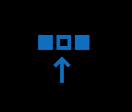




Starting your Azure Open AI journey
Request Access: https://aka.ms/oai/access
Create a new Azure Open AI Resource, open Azure Open AI Studio and explore
Configure
Models
Data Files
Deployments
Quotas
Play
Chat
Completion
DALL-E

Slide 26
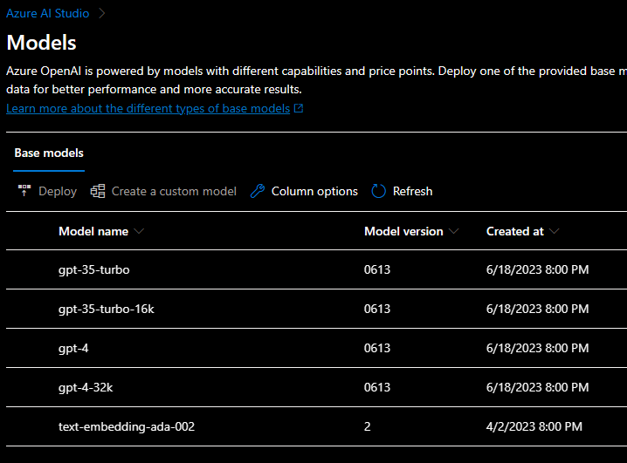
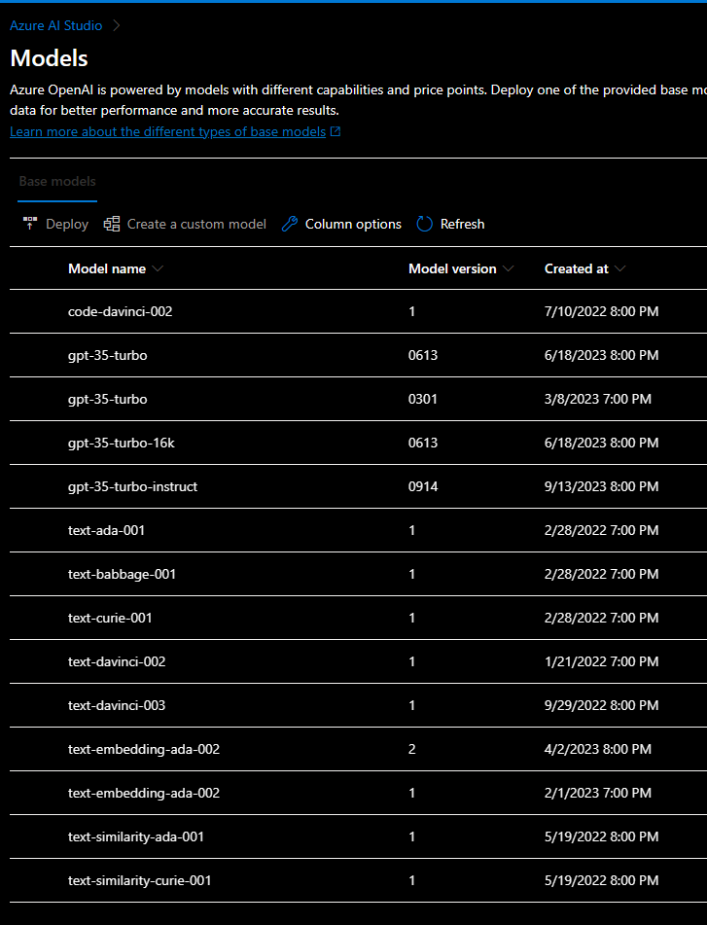
Azure Open AI - Models
Model availability varies by region, based on load. Some
Canada East
East US

Slide 27
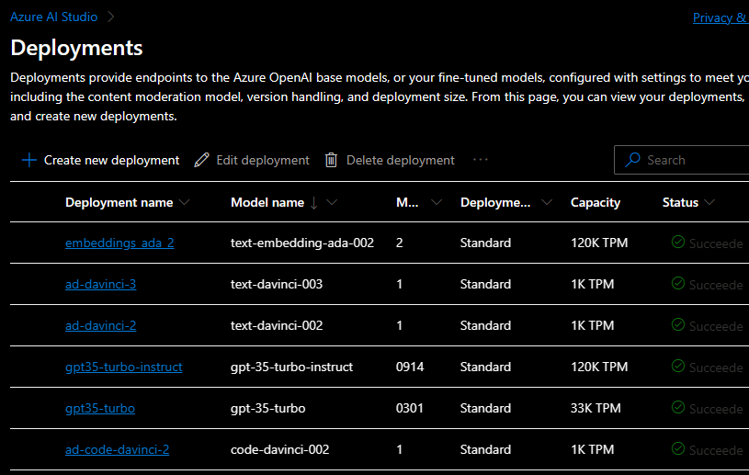
Azure Open AI - Deployments
Deployments are instances of a model, deployed as an API that you can access.
Still uses the same key as the parent OpenAI service but can have its own quota slice.

Slide 28
Azure Open AI - Quotas
Each Model has a certain throughput / capacity that you can use measured in Tokens Per Minute (TPM)
Note: Throughput is measured per model / per region
Share the same quota limit
120k TPM / 750 RPM
Notes:
Token per minute
Request per minute

Slide 29
Azure Open AI - Pricing
Sentence:
Azure OpenAI service is General Available now!
Tokens:
[AZ]-[ure] [Open]-[AI] [service] [is] [General] [Available] [now][!]
1 token is approximately 4 characters or 0.75 words.
Do you know:
The collected works of Shakespeare are about 900,000 words or 1.2M tokens.
Notes:
https://platform.openai.com/tokenizer
https://azure.microsoft.com/en-us/pricing/details/cognitive-services/openai-service/

Slide 30
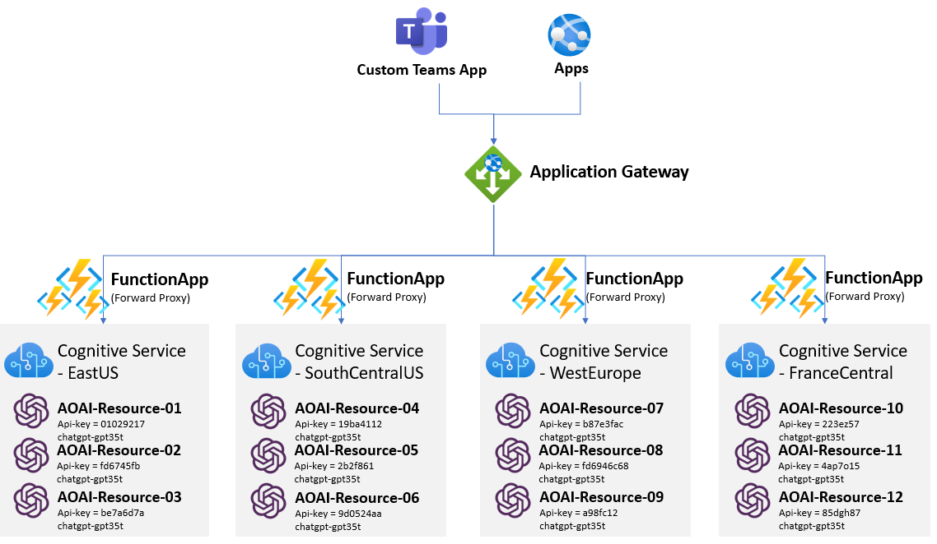
Load balancing multiple AOAI Resources
denlai-mshk/aoai-fwdproxy-funcapp (github.com)

Slide 31
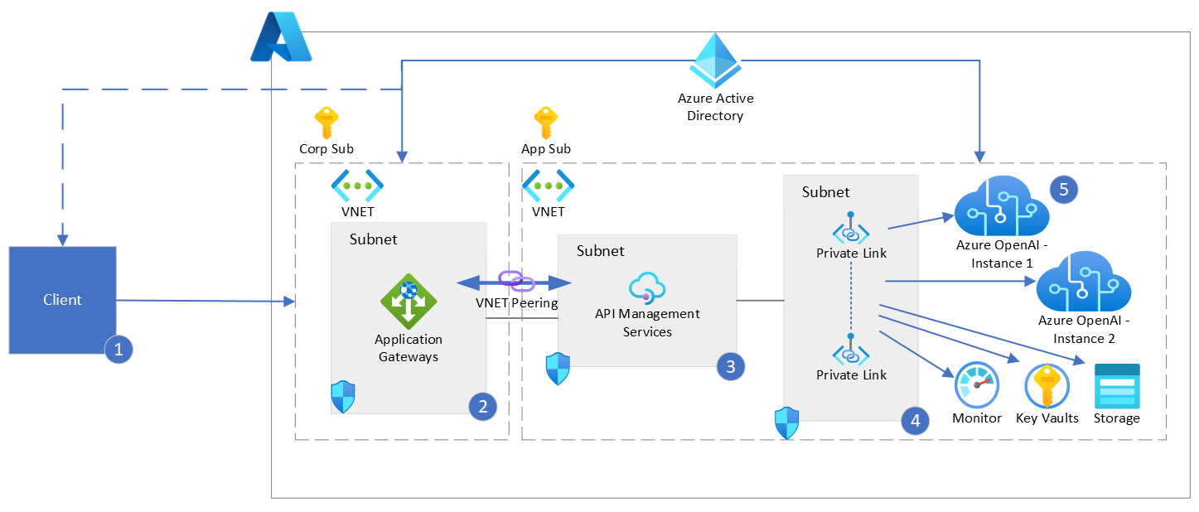
Enterprise reference architecture.
Notes:
https://github.com/Azure-Samples/openai-python-enterprise-logging
At this time, your Azure Open AI instance is the most valuable resource you have. This is where the cost can he high, and it’s rather scarce. This means you want to protect it as much as you can, as a bad actor can quickly run into limits and throttle all other APIs
Azure OpenAI service currently supports just a simple auth with one key per instance so if that key is compromised you could be in trouble.
Also it makes it hard to track WHO uses a resource (unless you deploy one AOAI instance per customer (which can be inneficient)
WE want as much as possible to “hide” that resource and access it though an API Manager which can ensure fair usage across clients / users, implement load balancing if needed and why not, track and associate cost to consumer.

Slide 32
Fine Tuning and Prompt Engineering
Notes:
Fine-tuning is the process of customizing AI models with your data and hyperparameters. It involves adjusting the parameters of a pre-trained model to improve its performance on a specific task. This is done by training the model on a smaller dataset that is specific to the task at hand
Prompt engineering is the process of designing and refining prompts to elicit desired responses from AI models. It involves understanding the capabilities and limitations of the model, and crafting prompts that effectively communicate the desired task and provide the necessary context for the model to generate accurate and relevant responses.

Slide 33
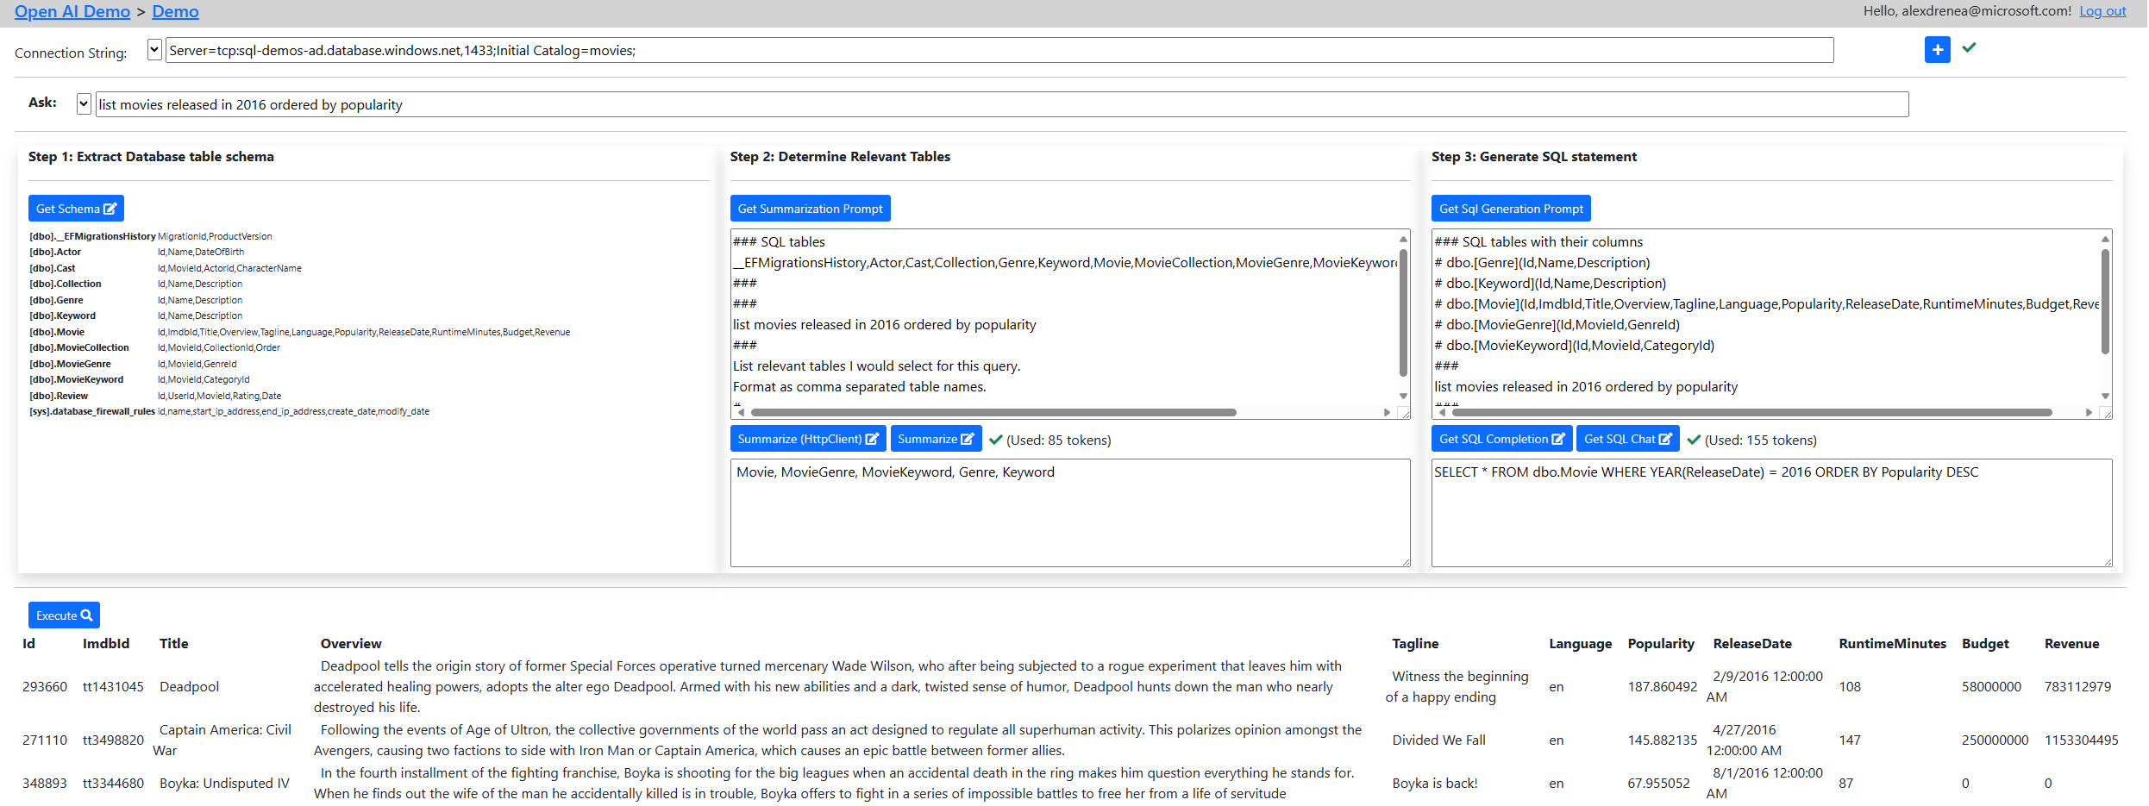
DEMO

Slide 34

hyper-realistic colorful question mark image

Slide 35

hyper-realistic colorful thank you image

